Slide 1



GUJARAT TECHNOLOGICAL UNIVERSITY
L.D. COLLEGE OF ENGINEERING AHMEDABAD
Institute Code: 028
Dissertation Phase 2 - (3740002)
Semester : 4 (M.E.)
Computer Engineering (Software Engineering)
“Garbage Image Classification using Deep Learning”
Prepared by:
Mishra Shubham V.
Enrollment Number:
220280702010
Internal Guide:
Prof. Parth R. Dave
Designation:
Assistant Professor

Slide 2
PRESENTATION OUTLINE
Introduction
Motivation
Literature Review
Comparative Analysis
Problem Statement
Objective
Proposed Methodology
Modification of Downsampling Process
Multi-Scale Feature Fusion Architecture
Integration of CBAM
Dataset and Precprocessing
ResNet-50 Model
ResNet-50 Architecture
Proposed Model
Proposed Model Architecture
Model Evaluation
Conclusion
Refernces

Slide 3
INTRODUCTION
Today, world generates close to 2.5 billion tons of garbage annually which can harm the environment if left unmanaged.
Recycling is done for waste management which includes steps like selection,classification and processing of the garbage which can be costly and time consuming.
For classification,deep learning techniques like CNN can be used.
We will investigate the result of modified version of ResNet-50 to classify the image into six different categories like Metal,Paper,Plastic,Glass,Cardboard and Trash.

Slide 4
MOTIVATION
The development of robust garbage image classifier is difficult because of various reasons like small dataset and quality of the images.
The images of the dataset also have issues like background,lighting,scale,frame and appearence.
The existing research in the Garbage image classification have small datasets and and computationally and resourcefully expensive.
There has been trade off between computation time and resources in the existing methods.
My motivation is to prepare a model which is efficient in classifying real world garbage images.

Slide 5
LITERATURE REVIEW
L

Slide 6
LITERATURE REVIEW
Sr No | Paper Title | Method and Dataset | Results/Conclusion
[1] | Research on Garbage Image Classification Based on Convolutional Neural Network | Inception V3 and Inception V4 convolutional neural networks are used Huawei's public garbage dataset (Garbage Date) was used for training | Inception V4 model is more stable and accurate than Inception V3. The accuracy rate of Inception V4 is 97.37%, and the accuracy rate of Inception V3 is 89.2%

Slide 7
LITERATURE REVIEW
Sr No | Paper Title | Method and Dataset | Results/Conclusion
[2] | X-DenseNet -Deep Learning for Garbage Classification Based on Visual Images | It combines Xception network with dense connections and multi-scale feature fusion The paper uses a dataset of 150 x 150 color garbage pictures. | X-DenseNet model achieves 94.1% accuracy in garbage classification. Reduces manual investment and improves garbage recovery rate

Slide 8
LITERATURE REVIEW
Sr No | Paper Title | Method and Dataset | Results/Conclusion
[3] | Image Recognition for Garbage Classification Based on Transfer Learning and Model Fusion | Proposed model GCNet for garbage image recognition using transfer learning and model fusion. Combined EfficientNetv2, Vision Transformer, and DenseNet for neural network model. Dataset contains 41,650 garbage images with data augmentation and is obtained from Crawler[Self Created dataset] | The fused model GCNet has a higher accuracy (97.54) compared to single models DenseNet (96.40), Vision Transformer (96.75), and EfficientNetV2 (96.12) on the test set. The proposed model, GCNet, showed good convergence, high recall rate and accuracy, and short recognition time Improves generalization

Slide 9
LITERATURE REVIEW
Sr No | Paper Title | Method and Dataset | Results/Conclusion
[4] | Depth-Wise Separable Convolution Attention Module for Garbage Image Classification | The paper proposes a Depth-Wise Separable Convolution Attention Module (DSCAM) It adopts a residual network as the backbone of DSCAM. Baidu garbage dataset (Baidu-214),Huawei dataset are used. | The results shows that the proposed method effectively classifies garbage images and outperforms some classical methods on five garbage datasets The proposed method has good generalization and can deal with garbage images in real world scene.

Slide 10
LITERATURE REVIEW
Sr No | Paper Title | Method and Dataset | Results/Conclusion
[5] | Garbage image recognition and classification based on hog feature and SVM-Boosting | The paper combines hog features and boosting algorithm to develop a SVM classification method for garbage image recognition and classification The experimental samples are divided into categories A, B, C, and D, and six SVM classifiers are designed The experiment uses SVM classifier and SVM boosting classifier for comparison and evaluation of accuracy Image Datset is Self Prepared using Smartphone | The classification efficiency of the SVM-Boosting algorithm is reported to be as high as 95% or even higher, which is about 10% higher than that of the single SVM classification method The paper concludes that the proposed SVM boosting algorithm, which combines hog features and boosting algorithm, improves the recognition efficiency of SVM in garbage image recognition and classification

Slide 11
LITERATURE REVIEW
Sr No | Paper Title | Method and Dataset | Results/Conclusion
[6] | Garbage Classification Using Deep Learning Techniques | Support vector machines (SVM) with HOG features were employed for garbage classification Basic CNN which consisted of 2D convolutional layers with 3x3 filters, max pooling layers, a flatten layer, and fully connected layers for classification were used CNN models with residual blocks, such as the ResNet50 architecture, were utilized. These models included two conv. layers with a 1x1 filter before and after a 3x3 conv. layer, creating a bottleneck structure | The paper compares different techniques for garbage classification using deep learning models, including support vector machines (SVM) with HOG features, basic convolutional neural networks (CNN), and CNN with residual blocks The SVM-based approach achieves a test accuracy of approximately 47.25% using the same training and test sets The combination of CNN models, with or without residual blocks, performs well for garbage classification

Slide 12
LITERATURE REVIEW
Sr No | Paper Title | Method and Dataset | Results/Conclusion
[7] | Automatic Image-Based Waste Classification | Various architectures of CNN like VGG,Inception and ResNet is used. The best classification results were obtained using a combined Inception-ResNet model with an accuracy of 88.6%. Image analysis techniques such as statistical moments, Fourier-based descriptors, Gabor-based descriptors, and Histogram Oriented Gradients (HOG). TrashNet Dataset having 2567 images was used. | The best classification results were achieved using a combined Inception-ResNet model with an accuracy of 88.6%. The ResNet model outperformed other deep learning models applied to waste classification, including the VGG-16 and VGG-19 models

Slide 13
LITERATURE REVIEW
Sr No | Paper Title | Method and Dataset | Results/Conclusion
[8] | Deep Learning based Smart Garbage Classifier for Effective Waste Management | A simple CNN on labelled dataset is used. Softmax activation function for output layer. TrashNet dataset is used here. | Achieved a testing accuracy of 76% using supervised learning. Maximum accuracy achieved is 76% at 100 Epochs and image size of 50x50. The classifier can be improved with a better dataset and more images. The proposed model can be automated for practical applications in households.

Slide 14
LITERATURE REVIEW
Sr No | Paper Title | Method and Dataset | Results/Conclusion
[9] | New Benchmark for Household Garbage Image Recognition | Dataset Household Garbage Images (HGI-30) is created by simulating different lightings, backgrounds, angles, and shapes and having 30 classes. CNN is applied on the HGI-30 and results were compared with SIFTBoVW, HOGSVM, MobileNet, VGG16, ReseNet50, DenseNet, XCeption, and EfficientDet | The average mAP(Mean Average precision) of the six target detection algorithms in this dataset was 76%. Overall, YOLOv4 achieved the best effect having average detection precison of 96%.

Slide 15
LITERATURE REVIEW
Sr No | Paper Title | Method and Dataset | Results/Conclusion
[10] | Research on deep learning image recognition technology in garbage classification | Model based on EfficientNet is used Group normalization (GN) is used instead of batch normalization (BN) to normalize the features within each group, as GN has stable accuracy under various batch sizes and reduces the error rate compared to BN. Data Augumentation is used to increase generality | The average accuracy of the garbage classification algorithm model based on deep learning was 93.47%, with the highest accuracy reaching 98.3% The loss rate of the model was approximately 0.3

Slide 16
COMPARATIVE ANALYSIS
Model | Accuracy(avg) | Advantages | Disadvantages
ResNet | 85-90% | High accuracy, well-established, good for transfer learning | Computationally expensive, large memory footprint
MobileNet | 75-80% | Lightweight, fast inference, suitable for mobile devices | Lower accuracy than deeper models, limited feature extraction capabilities
DenseNet | 80-85% | Efficient feature reuse, strong gradient flow, improved accuracy | More complex training, higher memory requirements
VGGNet | 70-80% | Simple architecture, easy to understand and interpret | Requires large datasets for good performance, can be computationally expensive
Inception | 80-85% | Multi-scale processing, improved feature representation | Complex architecture, can be time-consuming to train

Slide 17
PROBLEM STATEMENT
The quantity of data should be increased to improve the accuracy and robustness of the model
The images in the dataset are taken on the white background which is unrealistic in real world.
The downsampling process of residual blocks of ResNet-50 can be modified to decrease information loss.
In real world images, there can be noise and irrelevant informations,to overcome this we can use attention mechanisms to focus only on the important parts and ignore the irrelevant parts.
In CNN architectures, the filter size is constant which can lead to miss important information within a image.To tackle this we can use multi-scale feature fusion to better optimize the feature usage at different scales of the input image.

Slide 18
OBJECTIVE
The primary objective is to find a Deep learning technique and the method following that technique.
Under the Deep Learning,we are focusing on the CNN and its different architecture to achieve the maximum accuracy in Garbage Image Classification
Since we are dealing with the small datasets, we will try to optimize the use of features extracted.
We will also try to increase the robustness and generability of the model to increase the efficiency at real world Scenarios.
We will also perform the evaluation of the proposed model and validate the result.

Slide 19
PROPOSED METHODOLOGY
We are going to use ResNet-50 since it is has high accuracy and can train deeper network easily as can be seen by the comparative analysis.
To further improve the accuracy of model,residual block of the ResNet-50 are modified using following techniques :
(A).Insert Attention Module (CBAM) to filter the input features so that it Focus on only target object and ignore background interference.
(B).Modify the downsampling process to decrease the information loss.
(C).Integrate Multi-scale feature fusion to improve Generalisation which can help in real world image classification.

Slide 20
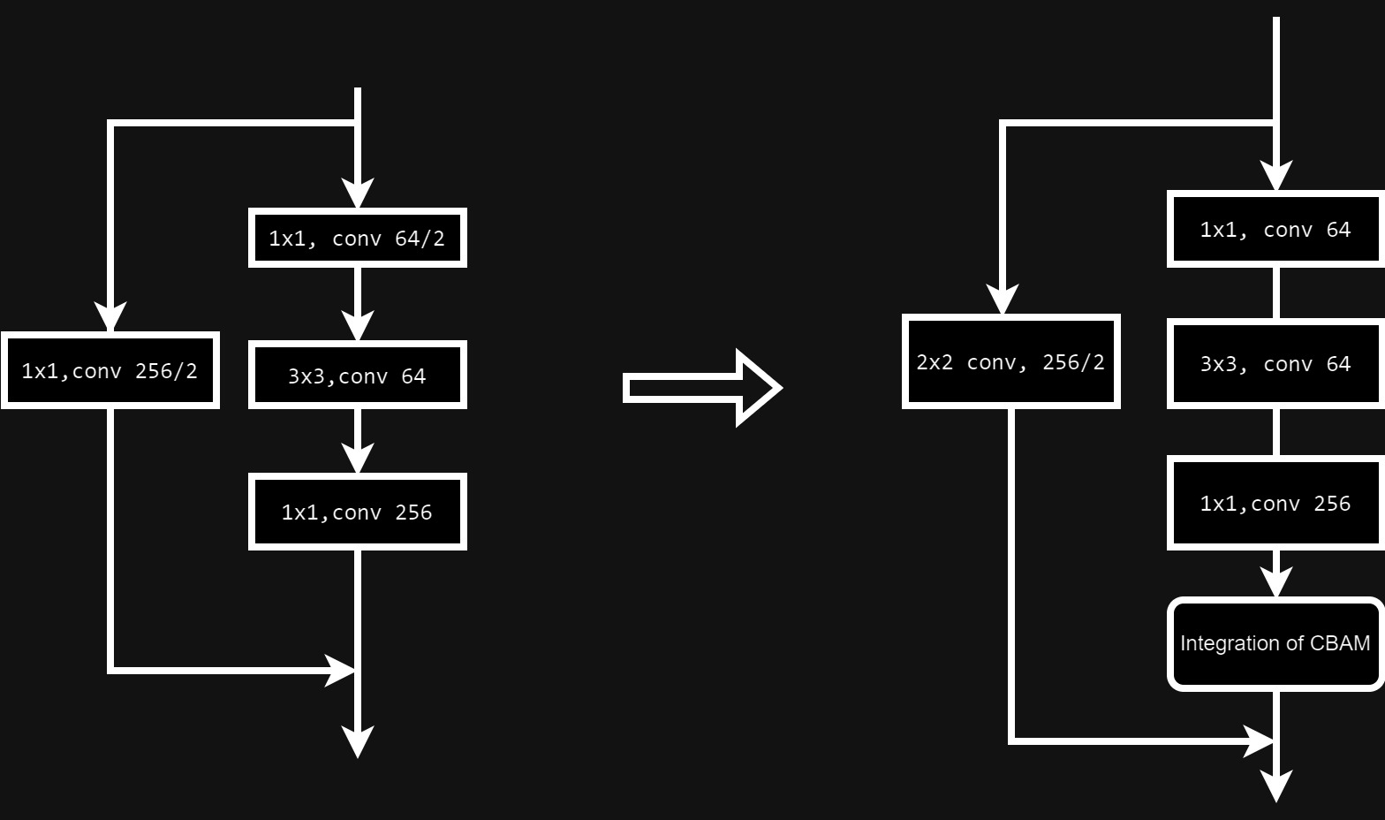
MODIFICATION OF DOWNSAMPLING

Slide 21
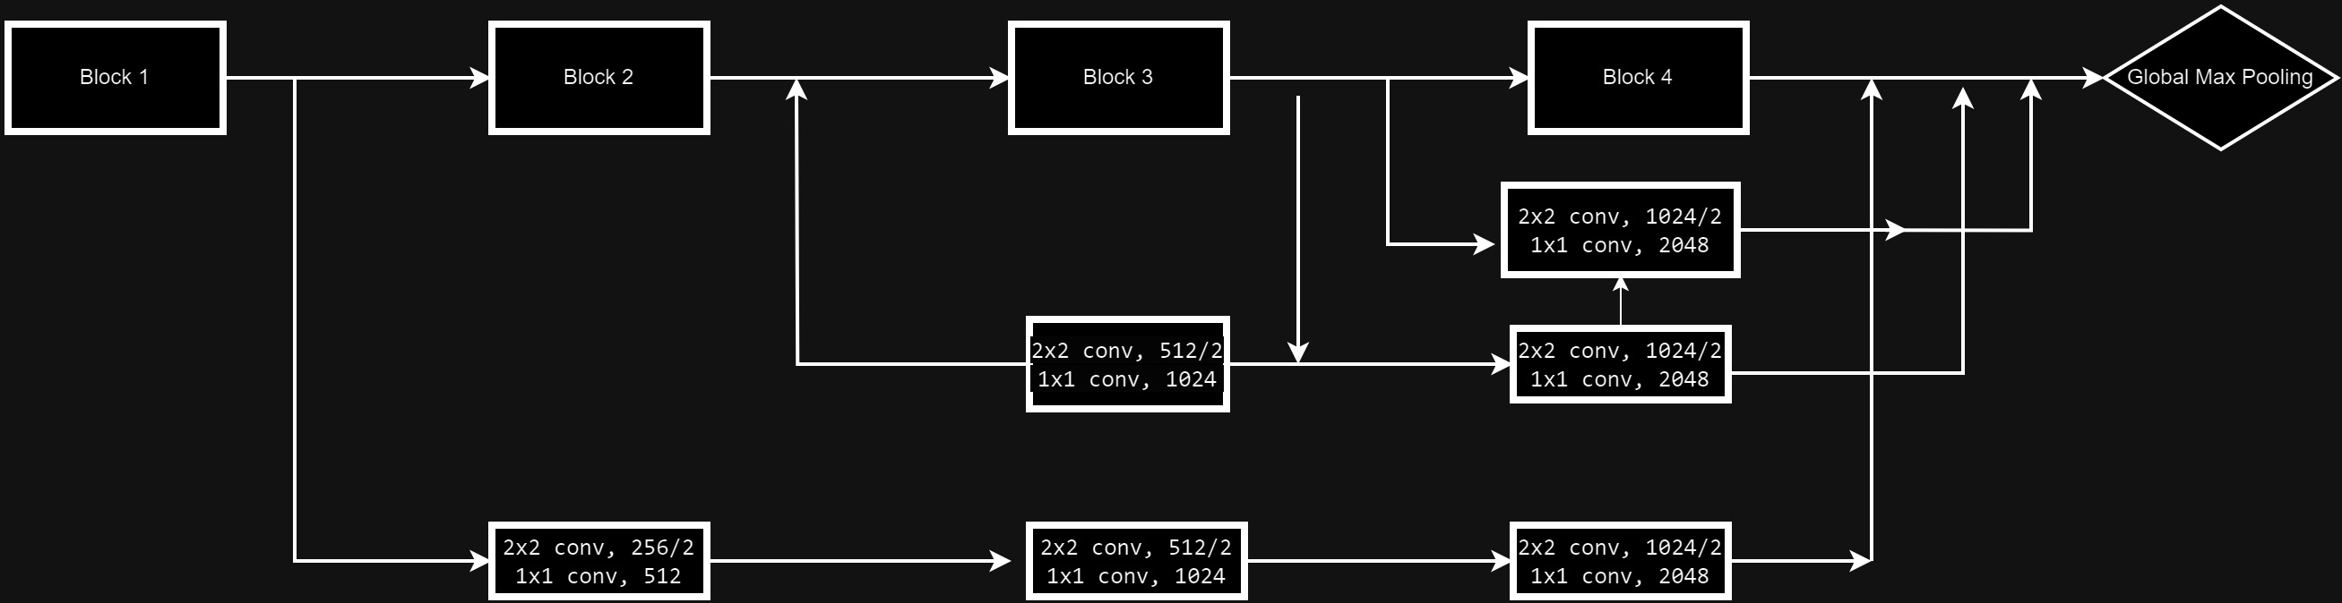
MULTI-SCALE FEATURE FUSION

Slide 22
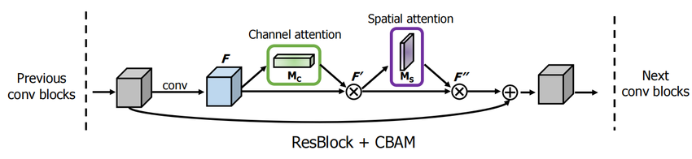
INTEGRATION OF CBAM MODULE

Slide 23
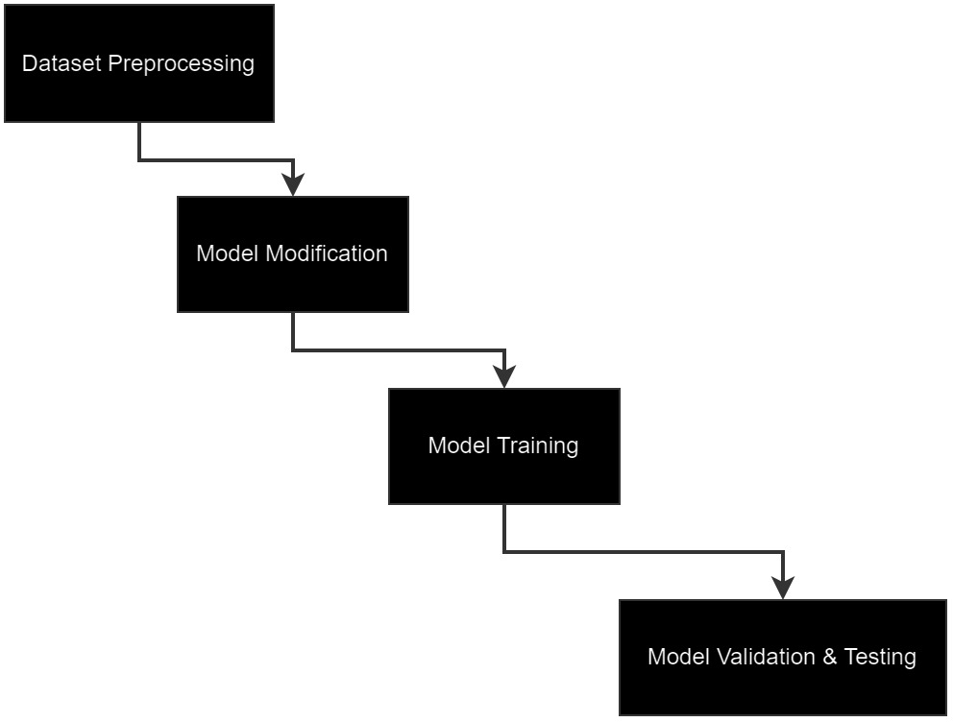
PROCESS FLOW OF THE SYSTEM

Slide 24
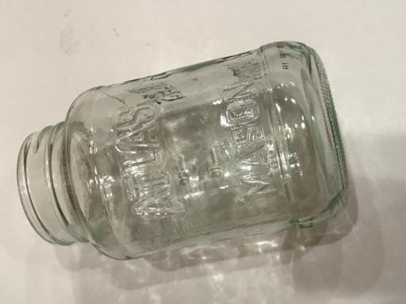
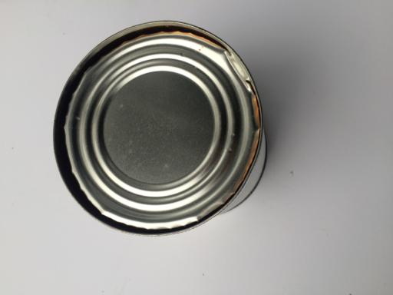
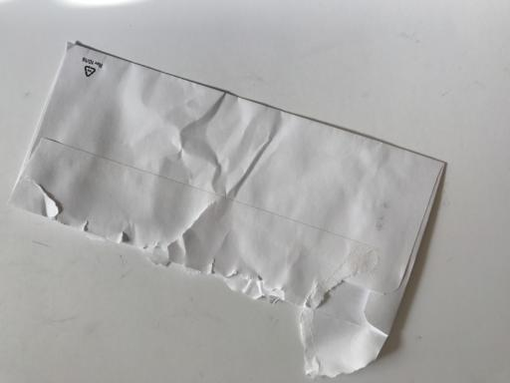
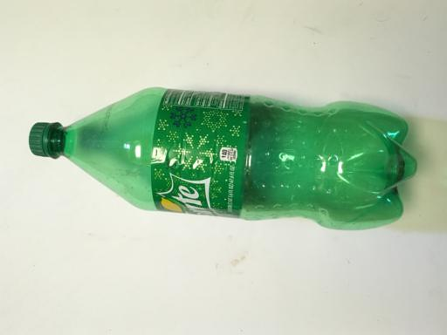
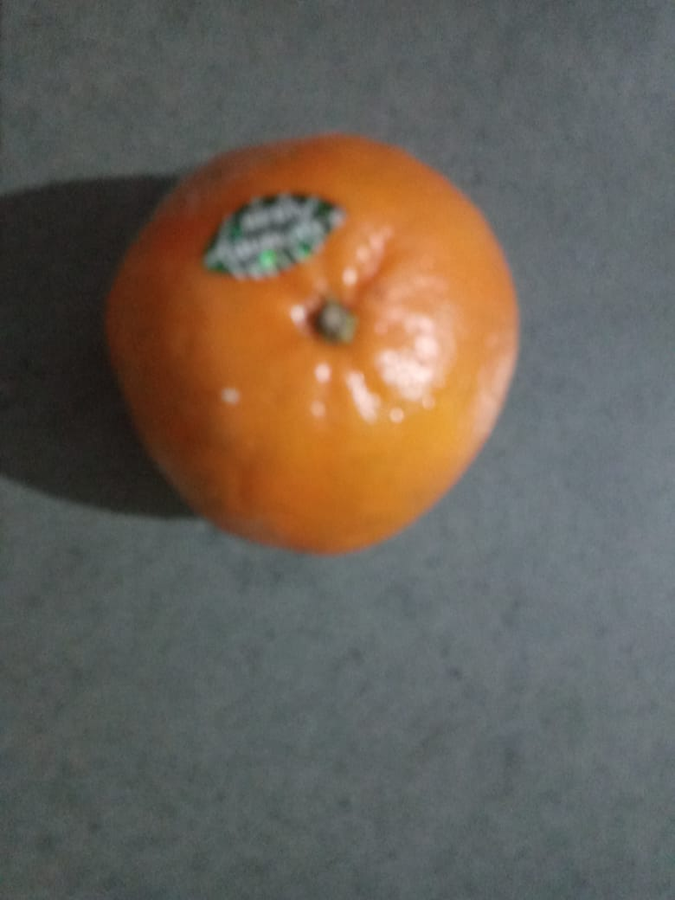
DATASET
The Dataset Contains 6 different categories of garbage namely
(1).Paper, (2).Plastic,(3).Metal,(4).Glass,(5).Card Board (6)Trash
To furture expand the dataset we apply Data Augumentation
New images captures using Smartphone camera will be added.
Size of image will be 512*318 pixels
Format will be jpeg.

Slide 25
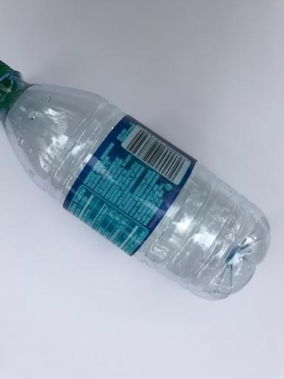
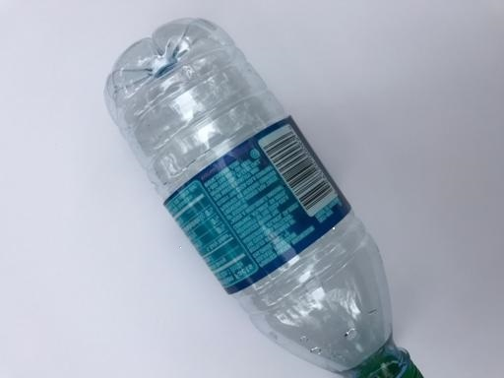
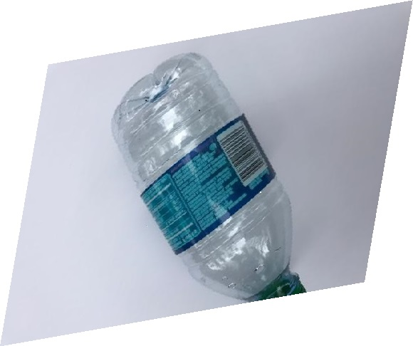
DATASET PREPROCESSING
Data Augumentation:
Various Data Augumentation techniques like flipping,scaling,cropping,rotation,etc are applied on the image to increase the size of the dataset.

Slide 26
DATASET PREPROCESSING
Total 2527 images are there in the dataset.
Total Images in the training set is:- 2021
Total Images in the validation set is:- 506
If we take 50 epochs, 32 batch size , then total number of images seen by the model will be
1,26,400 images including that of the augumented images.

Slide 27
RESNET-50 MODEL
RESNET-50 is a CNN Model Having 50 layers and skip or short-cut connections.
ResNet-50 has approximately 25 million trainable parameters, making it a deep but manageable network for training.
RESNET-50 have residual blocks made with the help of residual connections which helps them to train deeper networks without vanishing gradient problem.
MaxPooling Layer is used for pooling and ReLU is used as activation functions

Slide 28
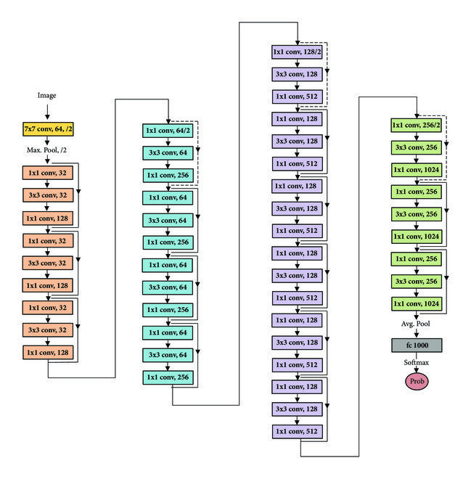
RESNET-50 ARCHITECTURE

Slide 29
PROPOSED MODEL
Total 225 are used including Convolution,Batch Normalization,Max Pooling ,Dropout layer,etc.
ReLU is used as the activation function in the hidden layers and softmax is used as the activation function in the fully connected layer.
Convolution layer of each residual block is modified for modification of the downsampling process
CBAM Attention module is attached after each residual block.
Global Average Pooling layer is added for feature aggregation

Slide 30
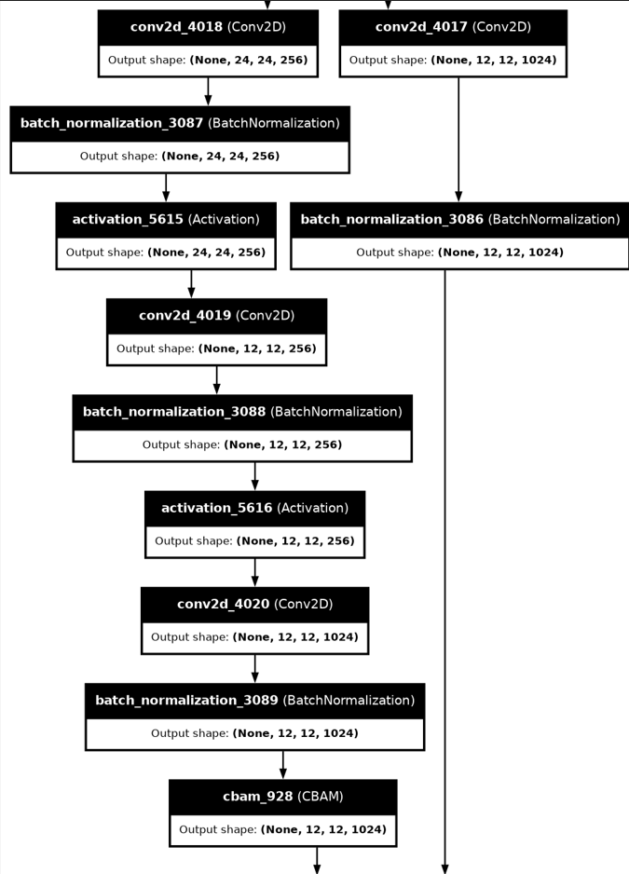
PROPOSED MODEL

Slide 31
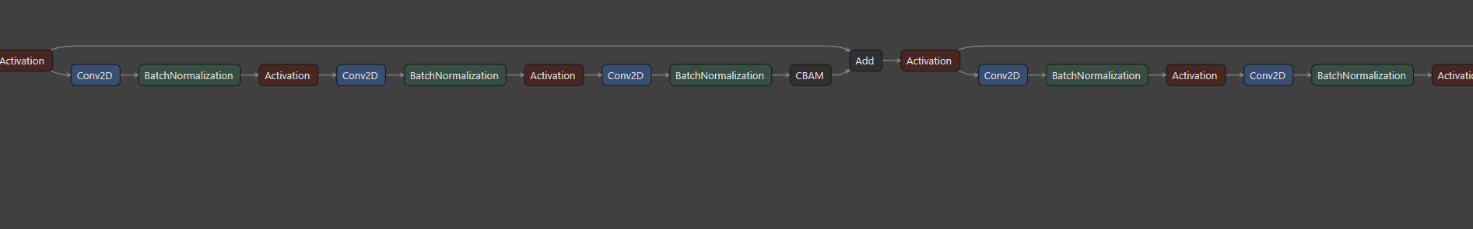
PROPOSED MODEL ARCHITECTURE

Slide 32
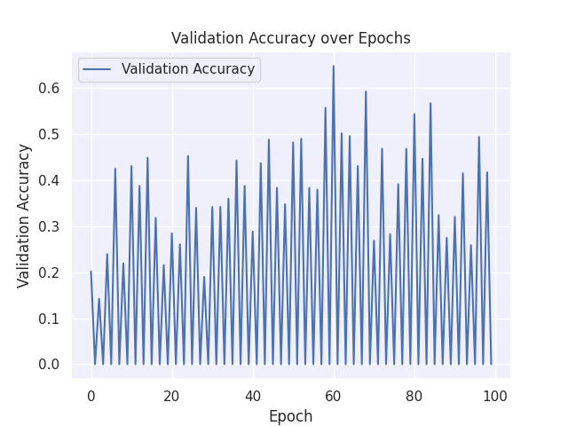
EVALUATION OF MODEL

Slide 33
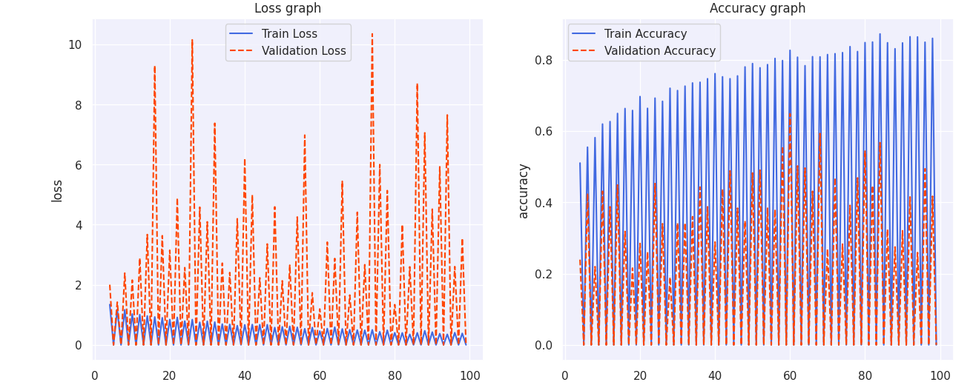
EVALUATION OF MODEL

Slide 34
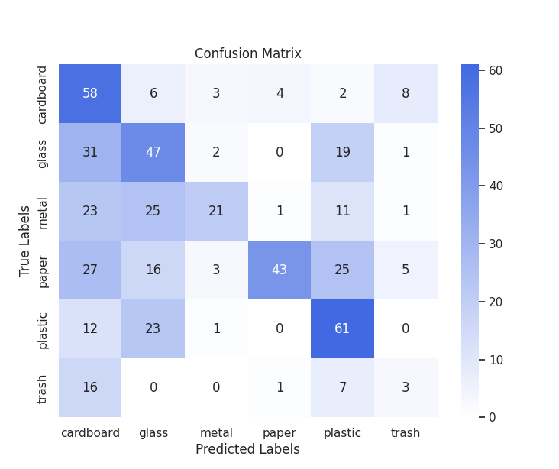
EVALUATION OF MODEL

Slide 35
CONCLUSION
In this research, I tried to modify the ResNet-50 structure to increase the efficiency and robustness on small size dataset by adding CBAM Module,modifying the downsampling and incorporating multi-scale feature fusion.
By trying to incorporate all above mentioned modifications, model becomes complex and number of trainable parameters increases.
After 50-55 epochs, model starts to overfit. CBAM helps focus only relevant information.But if it starts focusing irrelevant,the boon of CBAM can become curse.
Model architecture needs improvement.

Slide 36
REFERNCES
[1].Li, K. T. Z. W. Y. C. W. (2020). Research on Garbage Image Classification Method Based on Convolutional Neural Network. https://ijcat.com/archieve/volume9/issue1/ijcatr09011007
[2].Meng, S., Zhang, N., & Ren, Y. (2020). X-DenseNet: Deep learning for garbage classification based on visual images. Journal of Physics, 1575(1), 012139. https://doi.org/10.1088/1742-6596/1575/1/012139
[3].Liu, W., Ouyang, H., Liu, Q., Cai, S., Wang, C., Xie, J., & Hu, W. (2022). Image recognition for garbage classification based on transfer learning and model fusion. Mathematical Problems in Engineering, 2022, 1–12. https://doi.org/10.1155/2022/4793555
[4].Liu, F., Xu, H., Qi, M., Liu, D., Wang, J., & Kong, J. (2022). Depth-Wise separable convolution attention module for garbage image classification. Sustainability, 14(5), 3099. https://doi.org/10.3390/su14053099
[5].Wang, W., Baobao, Z., Wang, Z., FangZhi, Z., & Liu, Q. (2021). Garbage image recognition and classification based on hog feature and SVM-Boosting. Journal of Physics, 1966(1), 012002. https://doi.org/10.1088/1742-6596/1966/1/012002
[6].S. Meng and W. -T. Chu, "A Study of Garbage Classification with Convolutional Neural Networks," 2020 Indo – Taiwan 2nd International Conference on Computing, Analytics and Networks (Indo-Taiwan ICAN), Rajpura, India, 2020, pp. 152-157, doi: 10.1109/Indo-TaiwanICAN48429.2020.9181311.

Slide 37
REFERENCES
[8].S. R., R. P., V. S., K. R. and G. M., "Deep Learning based Smart Garbage Classifier for Effective Waste Management," 2020 5th International Conference on Communication and Electronics Systems (ICCES), Coimbatore, India, 2020, pp. 1086-1089, doi: 10.1109/ICCES48766.2020.9137938.
[9].Wu, Z., Li, H., Wang, X., Wu, Z., Zou, L., Xu, L., & Tan, M. (2022). New benchmark for household garbage image recognition. Tsinghua Science & Technology, 27(5), 793–803. https://doi.org/10.26599/tst.2021.9010072
[10].Q. Guo, Y. Shi and S. Wang, "Research on deep learning image recognition technology in garbage classification," 2021 Asia-Pacific Conference on Communications Technology and Computer Science (ACCTCS), Shenyang, China, 2021, pp. 92-96, doi: 10.1109/ACCTCS52002.2021.00027.

Slide 38


